Slide 1



Course Name software Development project management
CSC 4125
(Undergraduate)
Chapter 6 effort estimation
Software engineering (Undergraduate)
M. Mahmudul hasan
Assistant Professor, CS, AIUB
http://www.dit.hua.gr/~m.hasan

Slide 2
What makes a successful project?
MMH
Delivering:
agreed functionality
on time
at the agreed cost
with the required quality
Stages:
1. Set targets
2. Attempt to achieve targets
BUT what if the targets are not achievable?
A key point here is that developers may in fact be very competent, but incorrect estimates leading to unachievable targets will lead to extreme customer dissatisfaction.

Slide 3
Difficulties in software estimation
MMH
Novel (unique) applications of software: in most major project the product will in some way be unique and will therefore be clouded with doubts and uncertainty (not the system to be build similar to the previously built project but different customers)
Complexity and invisibility: a software project has logical complexity and invisible in nature
Changing technology: different technology used in the software application (e.g. earlier application was written in Cobol but in new extension it has to be developed in Oracle)
Lack of homogeneity of project experience: similar competence from earlier project experiences
Lack of standard definitions: scope of Interpretation often misunderstood
Subjective (individual) nature of estimating: people tend to underestimate the difficulties of small task and over-estimate that of large tasks.
Political implications: different groups within an organization have different objectives (e.g. software quality vs. budget and time)

Slide 4
Where estimates done?
MMH
Strategic Planning: an organization’s process of defining its strategy or direction, and making decisions on allocating its resources to pursue this strategy.
Feasibility Study: ascertain that the benefits of the potentials systems will justify the costs.
System Specification: definition of user’s requirements and the design that documents how those requirements are to be fulfilled; different design proposals need to be estimated for implementation.
Evaluation of Suppliers’ Proposals: e.g. tender proposal
Project Planning: scheduling (e.g. estimation on when staff will have completed particular tasks and be available for new activities)
Accuracy of estimates should improve as project proceeds
Some speculation(assumptions, wisdom) about physical implementation may be necessary for estimation (e.g. number of software modules to be developed)

Slide 5
Problems with over & under estimates
Slide-5
MMH
Over Estimates
An over-estimates might cause the project to take longer than it would otherwise
Parkinson’s Law – ‘work expands to fill the time available’, which implies that given an easy target staff will work less hard (Doesn’t apply universally, can be controlled)
Brooks’ Law – ‘putting more people on a late job makes it later’
Under Estimates
Weinberg’s Zeroth Law – ‘if a system does not have to be reliable, it can meet any other objective’
Demotivation and low productivity
Burnout (stress) and turnover
Having Realistic and Achievable Estimates is Critical
Artificial Urgencies and Deadlines MUST be avoided

Slide 6
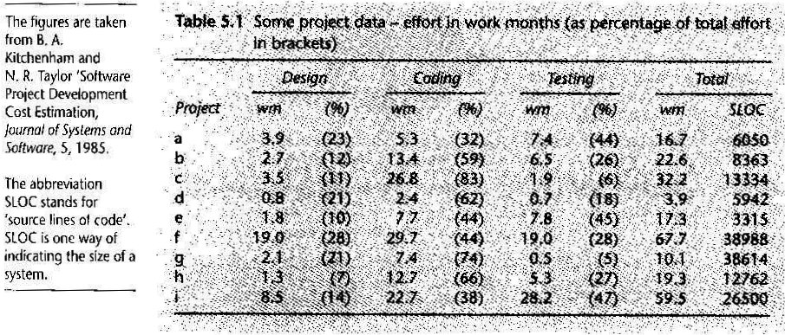
Basis for software estimating
Slide-6
MMH
Need for Historical Data (trends of forecasting the future from past)
Measure of Work (Size & time)
Complexity
Sample of Historical Data

Slide 7
Software effort estimation techniques
MMH
Algorithmic Models – use ‘effort drivers’ representing characteristics of the target system and implementation environment to predict effort
Expert Judgment – the advice of knowledgeable staff is solicited
Analogy – similar, completed projects are identified and their actual effort is used as a basis
Parkinson – identifies the staff effort (skills) available to do a project and uses that as an ‘estimate’
Price to Win – the ‘estimate’ is a figure that is sufficiently low to win a contract

Slide 8
Bottom-up estimating
MMH
Bottom-Up – Component tasks are identified and sized and these individual estimates are aggregated
Detailed Work Breakdown Structure (WBS) is made using either Top-Down or Bottom-Up Approach
Effort for each bottom-level activity is estimated
Estimates for bottom-level activities are added to get estimates for upper-level activities until overall project estimate is reached
Appropriate at later, more detailed, stages of project planning
Advisable where a project is completely novel or there is no historical data available

Slide 9
top-down estimating
MMH
Top-Down – an overall estimate is formulated for the whole project and is then broken down into the effort required for component tasks
Normally associated with parametric or algorithmic models (describe with finite no. of parameters)
Effort will be related mainly to variables associated to characteristics of the final system (and development environment)
Form of parametric model will normally be effort = (system size) x (productivity rate)
Important to distinguish between size models and effort models
After calculating the overall effort, proportions of that effort are allocated to various activities
Combinations of top-down and bottom-up estimation should be used

Slide 10
Estimating by analogy
MMH
Also called Case-Based Reasoning
Estimators seek out projects that have been completed (source cases) that have similar characteristics to the new project (target case)
Actual effort for the source cases can be used as a base estimate for the target
Estimators should then try to identify any differences between the target and the source and make adjustments to the base estimate
Problem is to identify similarities and differences between the source and target
Historical data must include all relevant dimensions included in the model
One method is to use shortest Euclidean distance to identify the source case

Slide 11
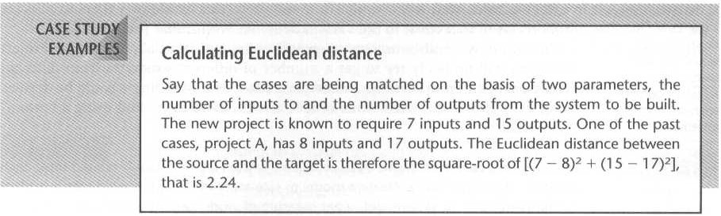
Calculating Euclidean distance
MMH
Euclidean Distance = square root of [(target_parameter_1 – source_parameter_1)power2 + … + (target_parameter_n – source_parameter_n)power2 ]

Slide 12
Albrecht (IFPUG) Function Point Analysis
Slide-12
MMH
Top-Down method devised by Allan Albrecht and later adopted by International Function Point User Group (IFPUG)
Quantifies the functional size of programs independently of the programming language in code
Based on five major components or ‘external user types’
External Input Types: input transactions that update internal computer files
External Output Types: transactions where data is output to the user, e.g. printed reports
Logical Internal File Types: group of data that is usually accessed together, e.g. purchase order file
External Interface File Types: file sharing among different applications to achieve a common goal
External Inquiry Types: transactions that provide information but do not update internal file, e.g. if a transaction is not complete in 3 days then the a/c is inactive.

Slide 13
Albrecht (IFPUG) Function Point Analysis
MMH
Each instance of each external user type in the system is identified
Each component is classified as having high, average, or low complexity
Counts in each complexity band are multiplied by specified weights and summed to get unadjusted FP count

Slide 14
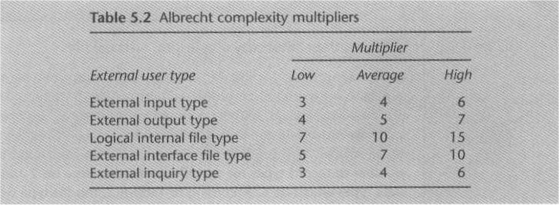
Fp complexity multipliers
MMH

Slide 15
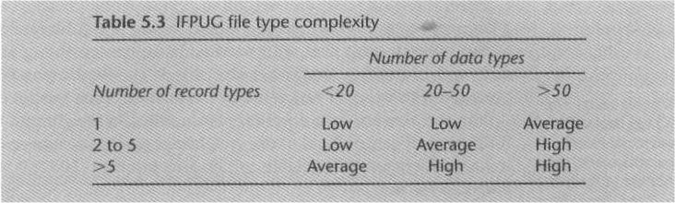
Fp file type complexity
MMH
Record type – purchase order details (order number, supplier reference, order date) purchase order item (product code, unit price, number ordered)
Here, the record type is 2 & data types 6

Slide 16
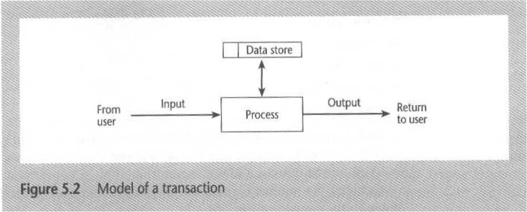
Model of a transaction
MMH

Slide 17
Function Points mark II
MMH
Recommended by Central Computer and Telecommunications Agency (CCTA)
Un Adjusted Functional Points (UFPs) = Wi x (number of input data element types) + We x (entity types referenced) + Wo x (number of output data element types)
where Wi, We, and Wo are weightings derived from previous projects or industry averages normalized so they add up to 2.5

Slide 18
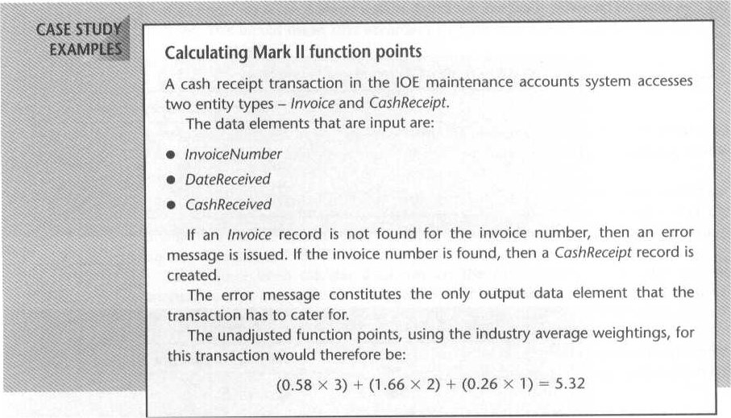
Function Points mark II
MMH

Slide 19
COCOMO (Constructive Cost Model)
MMH
Based on SLOC characteristic, and operates according to the following equations:
Effort = PM = Coefficient_{<Effort Factor>}*(SLOC/1000)^P [100,000 SLOC/1000 = 100k SLOC]
Development time = DM = 2.50*(PM)^T
Required number of people = ST = PM/DM
PM : person-months needed for project (labor working hours) SLOC : source lines of code P : project complexity (1.04-1.24) DM : duration time in months for project (week days) T : SLOC-dependent coefficient (0.32-0.38) ST : average staffing necessary
Software Project Type | Coefficient _{<Effort Factor>} | P | T
Organic | 2.4 | 1.05 | 0.38
Semi-detached | 3.0 | 1.12 | 0.35
Embedded | 3.6 | 1.20 | 0.32

Slide 20
COCOMO (Constructive Cost Model)
MMH
Organic: relatively small, simple software projects in which a small teams with good application experience work to a software development project (e.g. showing VUES information to webpage)
Semidetached: an intermediate (in size and complexity) software project in which teams with mixed experience levels works in a mix of hardware and software application (e.g. biometric log-in time saved in VUES database)
Embedded: A software project that must be developed within a strongly coupled to hardware environment (e.g. biometric device, elevator)

Slide 21
references
MMH
Bob Hughes and Mike Cotterel (1999). Software Project Management (Second Edition).
PMBOK Guide: Project Lifecycle (5th Edition)

